Slide 1

TEAM : THE BRAINIACS
NAME: | COURSE | SEMESTER | CONTACT NO.
TANIYA KUMARI | BTECH | 2ND | 9693206292
JASSI KUMARI | BTECH | 2ND | 7631676826
SUMIT KUMAR | BTECH | 2ND | 9708198285
RISHAV KUMAR | BTECH | 2ND | 7541890964
NEHA KUMARI | BTECH | 2ND | 9334964090

Slide 2


PROBLEM STATEMENT:-
Create a recipe sharing website that allows user to upload search, and organise recipes , with options for meal planning and shopping list.
This Photo by Unknown Author is licensed under CC BY-SA-NC

Slide 3


Flavour flash:- This is a website to a streamline the cooking process by providing a proper guideline to those who present a web application for users to browse, and contribute their own recipes also provides a platform where any users who like to cook can explore others recipes and post sharetheir own recipes.

Slide 4

USER PROFILE:
USER TYPE : customer or creator.
BASIC DETAILS: Name , username, email’
ADDRESS : location , contact information.
PREFERENCES : language, theme ,notification preference
FOOD TYPE : veg and non veg.
CONTACT ME OR FOLLOW BUTTON:
Recipe management:-
It allows to upload recipe ,image and instruction and ingreidients
Allows to rate the item .
Shows the preparation time , reciepe type of the item.

Slide 5

Search and organise:-
search by ingredient , category , cookingyime and difficulty,
Saved and favourite food.
Advanced filtering of food
According to your diet plan.
meal planning:-
weekly planner meal.
auto integrated shopping list.
Food according to preference.
This Photo by Unknown Author is licensed under CC BY-NC-ND

Slide 6

shopping list integration
Auto addition of your fav food item or required combination with food.
Its totally editable.
Export the added food as the PDF sync with grocery delivery.
s

Slide 7
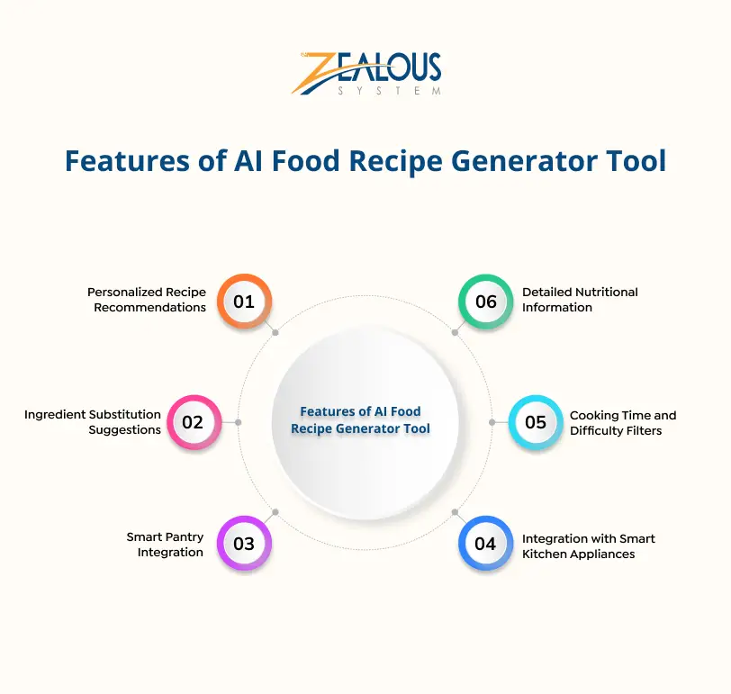

Prototype:-

Slide 8

TECHNICAL AND BUISNESS FEASIBILITY
FRONTEND :- VERCEL/ NETLIFY
BACKEND :- AWS EC2/ DIGITAL OCEAN
DATABASE :- MANGO DB/ ATLAS/SQ
CDN FOR IMAGE :- CLOUDING FIXBASE STORAGE.
Y

Slide 9
CONCLUSION AND FUTURE SCOPE.
The interaction procedure of user and the online application can be further more improved to make it interactive and user friendly.
One of the major problem, currently we can not provide online transaction.
We are trying to upgrade it into a advanced cryptography secured system with convenient interface so that more users can be attracted. We think more flexibility and interactive features can make it more bigger.

Slide 10

Thank you
That’s all about the problem statement .

